Slide 1
HIA303: Health Data Analytics
Data Analysis and Diagnosis Prediction of Breast Cancer Dataset
Group members:
Tee Kar Men
Nuraini Muhammad Naim
Lee Zi Sheng

Slide 2
Data pre-processing
By Tee Kar Men

Slide 3
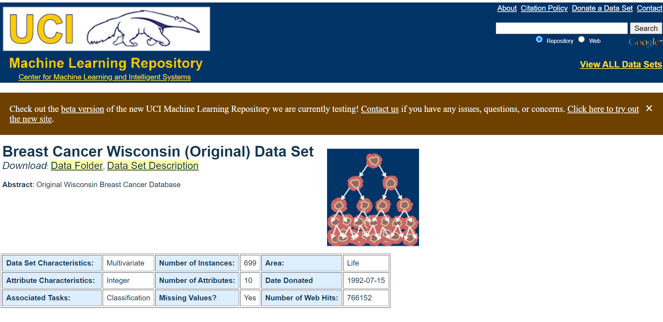
Data source
Source: https://archive.ics.uci.edu/ml/datasets/breast+cancer+wisconsin+%28original%29

Slide 4
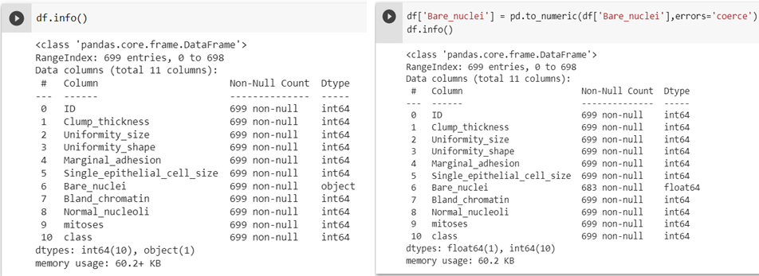
Overview of dataset
699 instances, 11 attributes
All except Bare Nuclei are integer values
Conversion from object to float

Slide 5
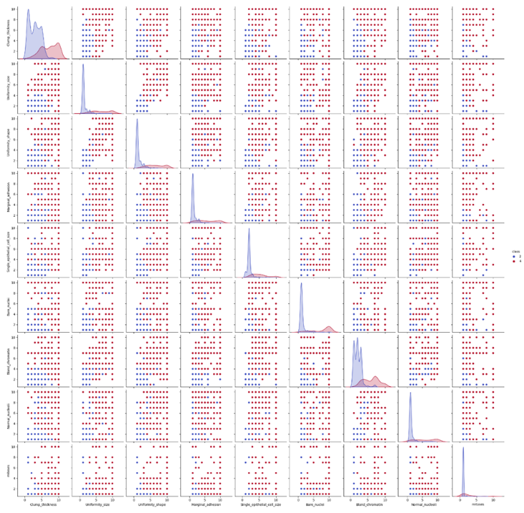
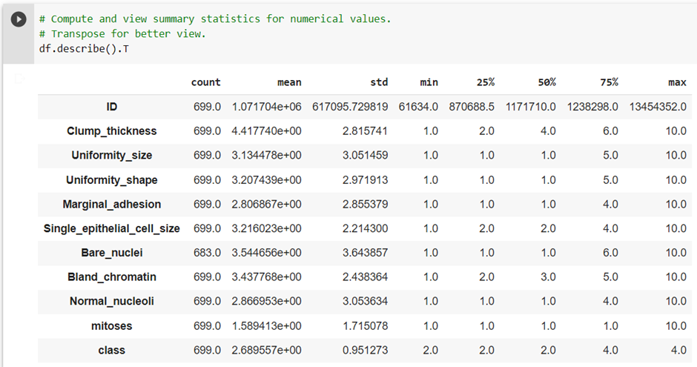
Exploratory data analysis
Summary of basic statistics for the dataset
Heatmap to visualize relationship and distribution

Slide 6
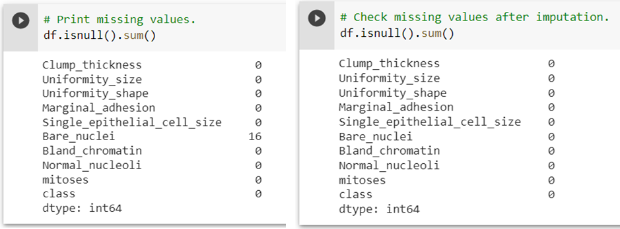
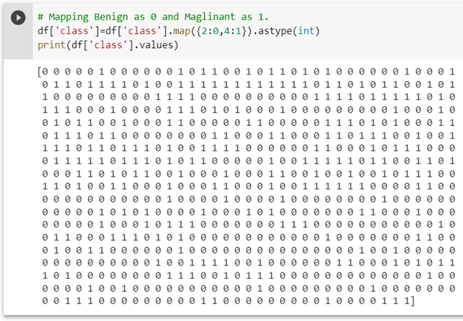
Data cleaning, encoding and transformation
Removed the ID number
There were 16 instances in Bare Nuclei with missing values
Imputation using k-NN algorithms
Class variable was encoded: 0 for Benign, 1 for Malignant

Slide 7
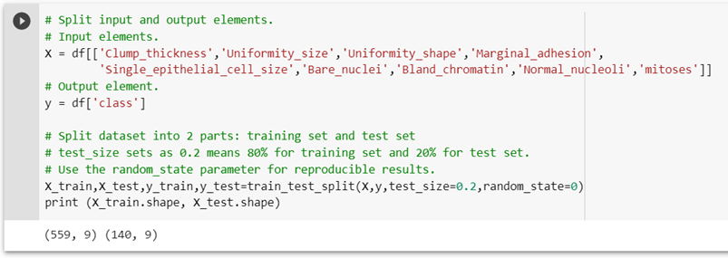
Train-test split
A dataset is split into 2 sets:
Training set: to train the machine
Test set: to evaluate the performance of the model
For our project, we decided to split the dataset in 4:1 ratio with 80% of instances being placed in the training set and 20% in the test set.

Slide 8
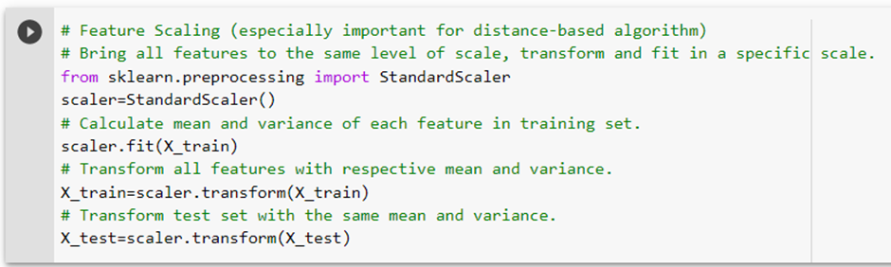
Feature scaling
This step is important in making sure all features are scaled to the same level prior to modelling.

Slide 9
Selecting the machine learning techniques
By Nuraini Muhammad Naim

Slide 10
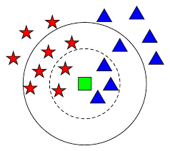
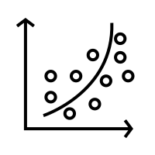
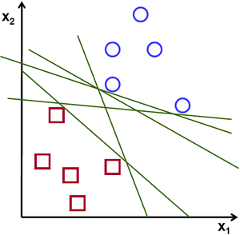
Selection of machine learning techniques
K-Nearest Neighbour
Logistic regression
Support Vector Machine
Can be used for classification & regression problems.
Assumes similar things exist in close proximity.
Uses distance-based algorithm.
K refers to the number of nearest neighbours to include in the voting process.
Used for classification problems.
Based on dependent variables, can further be classified into:
binomial: only 2 possible outcomes e.g. yes & no
Multinomial: 3 or more outcomes with no quantitative significance) e.g. “Group1”, “Group2”, “Group3”
Ordinal: 3 or more outcomes with quantitative significance e.g. “Bad”, “Good”, “Excellent”.
Can be used for regression and classification problems.
Separates data by identifying a hyper-plane or line.
Able to solve problem for non-linear datasets.
3 Components:
Kernel: transforms 2D datasets into 3D datasets
C: controls error
Gamma: decides the decision boundary to classify data

Slide 11
Model evaluation

Slide 12
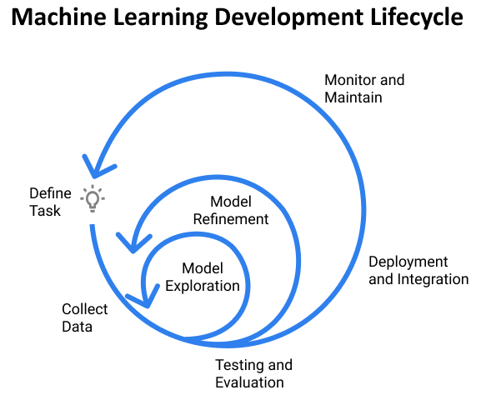
Model evaluation
To evaluate the performance of the model.
Why?
How accurate is the model?
Will a larger training improve the performance?
Is the model under-fitting or over-fitting?
Ultimately determines the suitability of using the model and improve its performance.
Source: https://www.jeremyjordan.me/ml-projects-guide/

Slide 13
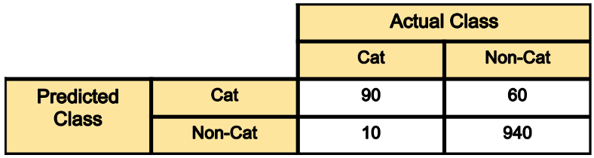
Confusion matrix
Also known as the error matrix that visualises the predicted results versus the ground-truth labels.
True positive: Predicted to be true and found to be true in reality
True negative: Predicted to be false and found to be false in reality
False positive (Type I error): Predicted to be true but found to be false in reality.
False negative (Type II error): Predicted to be false but found to be true in reality.

Slide 14
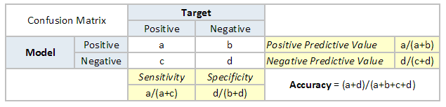
Evaluation metrics
Accuracy = (True positive + True negative) / total prediction
Precision = True positive / (True Positive + False Positive)
Recall = True positive / (True Positive + False Negative)
F1 = 2 / [ (1/precision) + (1/recall) ] or
2 * ( (precision * recall)/ (precision + recall))

Slide 15
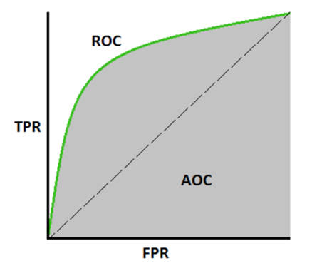
Receiver Operating Characteristics (ROC) curve
The ROC curve shows the true positive rate against false positive rate for various threshold values.

Slide 16
Applying the algorithms
By Lee Zi Sheng

Slide 17
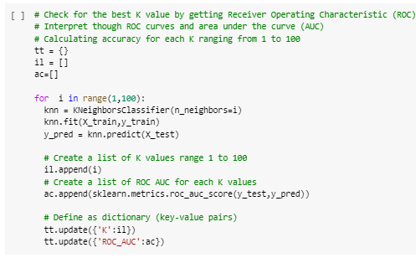
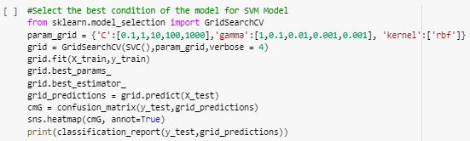
Preparations prior to applying the machine learning models

Slide 18
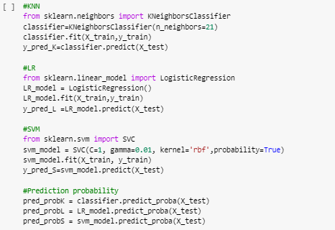
Running the algorithm

Slide 19
Evaluation results

Slide 20
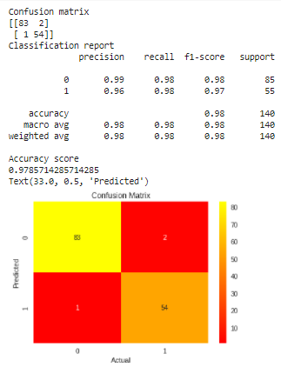
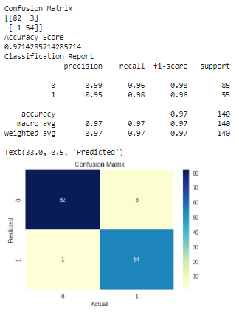
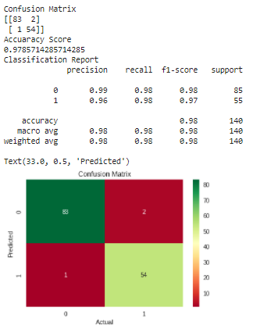
Evaluation of models
K-NN | Logistic regression | Support vector machine

Slide 21
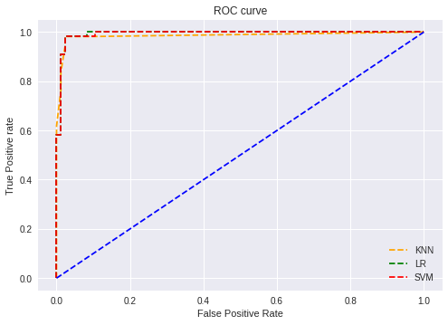
Receiver Operating Characteristics (ROC) curve & Area Under Curve (AUC)

Slide 22
Summary

Slide 23
Summary
Confusion matrix: KNN & SVM scored higher with
137 correct values
Precision: 99%
F1 score: 0.98
Accuracy: Higher in KNN and SVM
AUC: Highest in LR & SVM
Conclusion: SVM scored highest in all the evaluation metrics and therefore the better model to apply in this dataset.
 |  | K-NN | LR | SVM
Accuracy score |  | 97.6% | 97.1% | 97.6%
Precision | Benign | 0.99 | 0.99 | 0.99
 | Malignant | 0.96 | 0.95 | 0.96
Recall | Benign | 0.98 | 0.96 | 0.98
 | Malignant | 0.98 | 0.98 | 0.98
F1 score | Benign | 0.98 | 0.98 | 0.98
 | Malignant | 0.97 | 0.96 | 0.97
AUC |  | 0.986 | 0.993 | 0.993

Slide 24
Conclusion
Machine learning techniques work by building a statistical model based on training data in order to make predictions.
Different techniques apply different algorithms in dealing with the data and therefore would have different sets of advantages and disadvantages.
A good understanding of the available dataset and the expected outcome is very important in deciding on the appropriate machine learning technique.
Evaluation is very important in determining the performance of the model.

